Slide 1

PRESENTATION
HR Analytics Dashboard: Employee Attrition and Retention Insights
By Praveen s

Slide 2
Agenda
1. Project Overview 6. Power BI Dashboard
2. Dataset Overview 7. Tableau Dashboard
3. Problem Statement 8. Key Insights
4. Excel Dashboard 9. Recommendations
5. MySQL Scripts 10. Conclusion

Slide 3
Project Overview
The HR Attrition Analysis project uses HR analytics techniques and interactive dashboards to examine employee turnover patterns across departments, salary groups, job roles, promotions, working experience, and work-life balance factors.
The project was developed using Excel, MySQL, Power BI, and Tableau, where multiple HR datasets and tables were merged and analyzed using SQL queries, KPI calculations, and dashboard visualizations to generate meaningful workforce insights.
The analysis focuses on key HR KPIs such as attrition rate, retention rate, employee income, promotion history, job satisfaction, and average working years to identify workforce trends and high-risk employee groups.
Using dashboard reporting and visualization techniques, the project helps management monitor employee behavior, evaluate retention challenges, and support data-driven HR decision-making to improve employee engagement, retention strategies, and long-term workforce stability.

Slide 4

Dataset Overview
The IBM HR Analytics Employee Attrition & Performance dataset is a human resources dataset containing employee-related information such as age, department, education, job role, salary, work experience, job satisfaction, and work-life balance. It provides detailed insights into employees working across different departments of an organization and helps in understanding overall workforce structure and employee characteristics.
The dataset was created by combining two separate tables, HR1 and HR2, using an inner join based on the unique employee identifiers (EmployeeNumber in HR1 and Employee_ID in HR2). This merging process integrates employee demographic, job-related, salary, and performance information into a single unified dataset.
In addition to the original attributes, new derived features were added for better analysis, such as Attrition Flag, Monthly Income Band, Years Since Last Promotion Band, and Job Satisfaction Level.
The dataset also includes important HR factors like monthly income, performance rating, years at company, promotion history, overtime status, and relationship satisfaction. It is widely used for HR reporting, employee attrition analysis, dashboard creation, and organizational studies to support data-driven decision-making in human resource management.
IBM HR Analytics Employee Attrition & Performance

Slide 5
Problem statement
Employee attrition is one of the major challenges faced by organizations because it directly impacts productivity, recruitment costs, employee morale, and overall business performance. The company aims to analyze employee attrition patterns by studying factors such as department-wise attrition, salary structure, work-life balance, promotion history, working experience, and job roles.
The objective of this analysis is to identify the key reasons behind employee attrition and uncover trends that can help management improve employee retention strategies. By using HR analytics dashboards and visual reports, the organization can better understand workforce behavior and make data-driven decisions to enhance employee satisfaction and organizational stability.
This report focuses on:
Average attrition rate across all departments
Average hourly rate of male research scientists
Relationship between attrition rate and monthly income stats
Average working years for each department
Job role versus work-life balance analysis
Relationship between attrition rate and years since last promotion
Additional optional dashboards and charts for deeper HR insights
The analysis will help HR teams identify high-risk employee groups, understand compensation-related concerns, and evaluate whether career growth opportunities and work-life balance influence attrition.

Slide 6
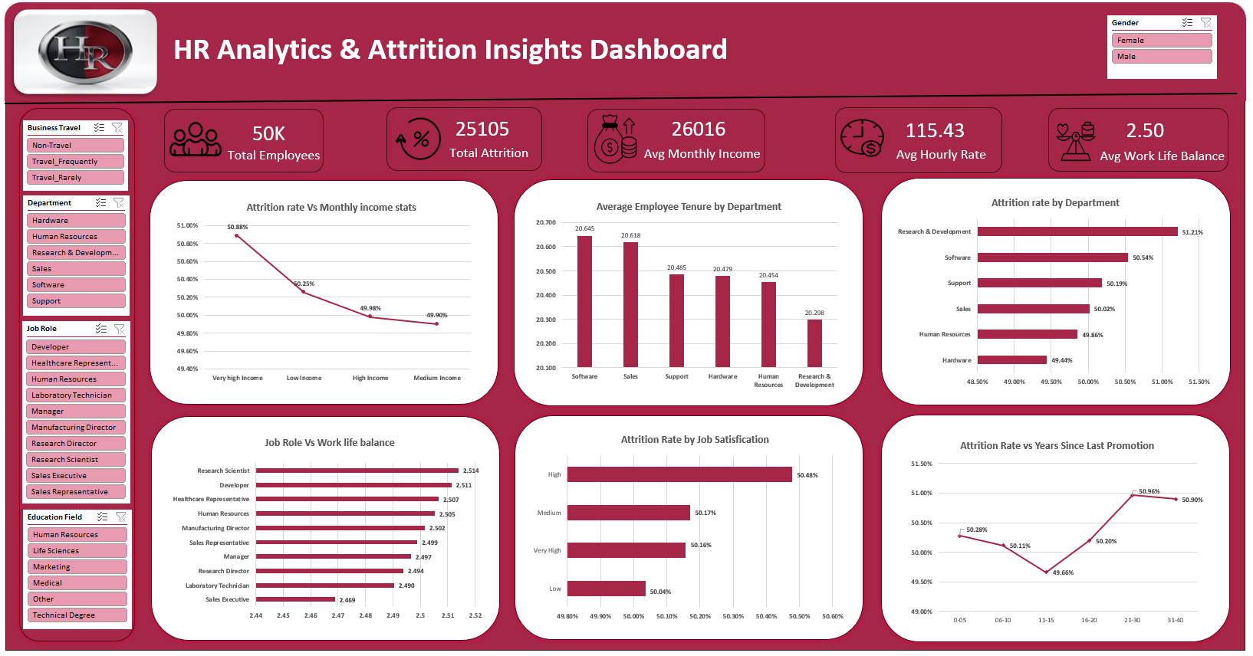
Excel Dashboard

Slide 7
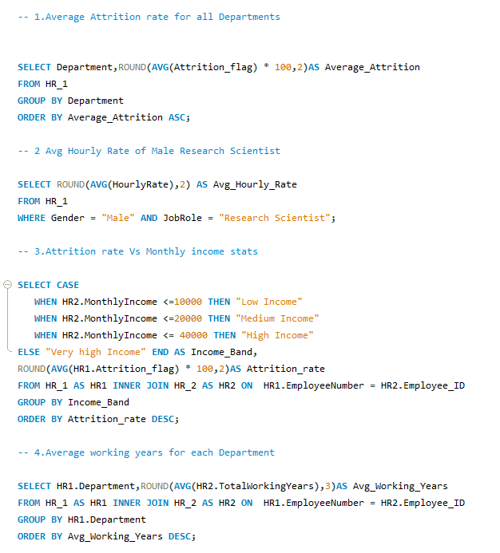
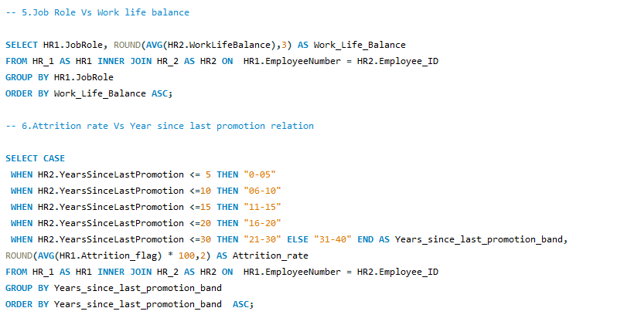
MySQL Scripts

Slide 8
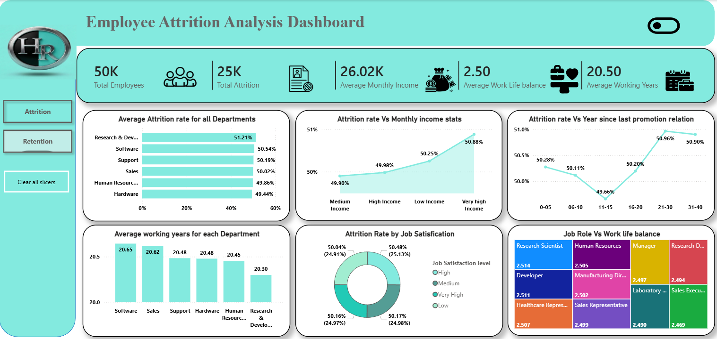
Power BI Dashboard

Slide 9
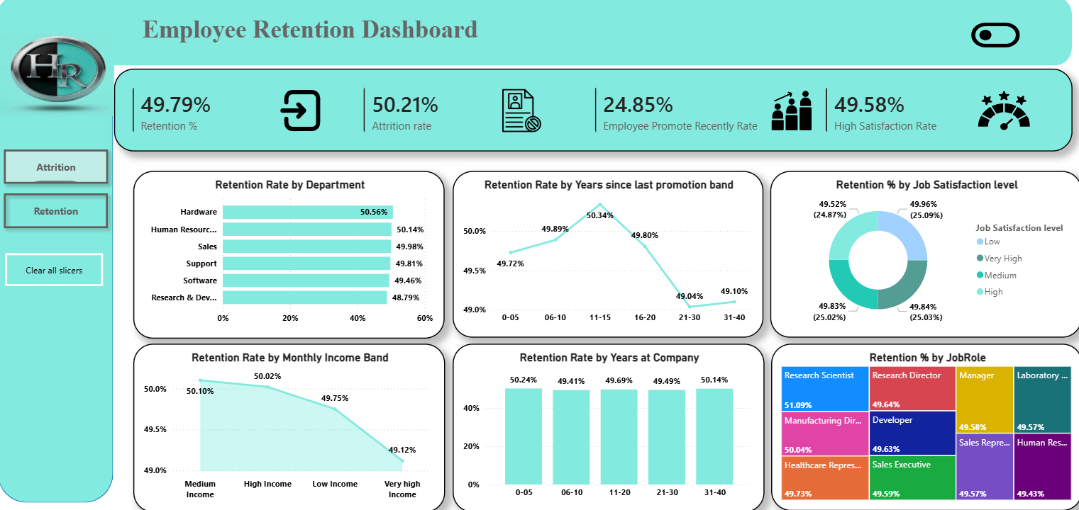
Power BI Dashboard

Slide 10
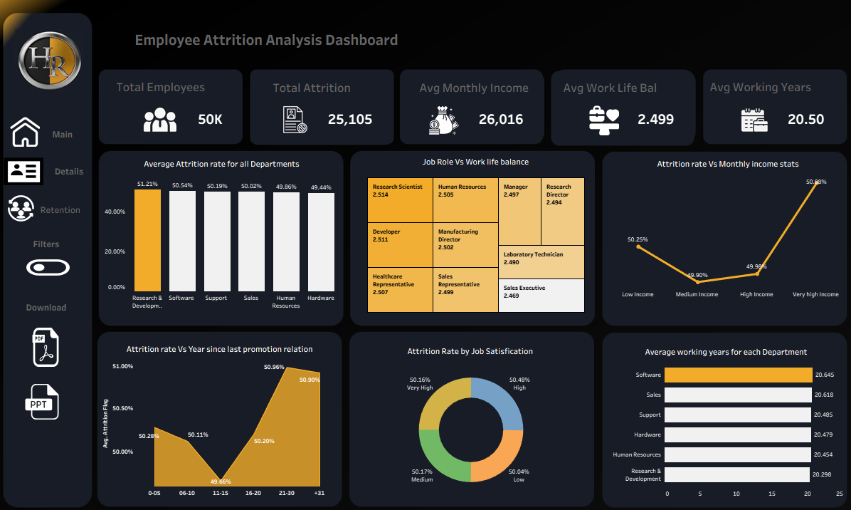
Tableau Dashboard

Slide 11
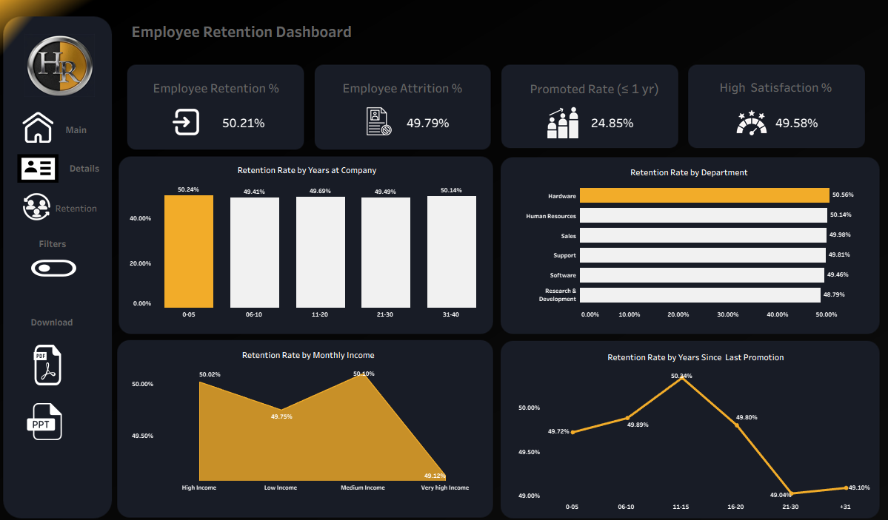
Tableau Dashboard

Slide 12
Key Insights
KPI analysis shows the Average Monthly Income is 26.02K, yet employees in the Very High-Income group still show the highest attrition at 50.88%, proving compensation alone is not sufficient to improve employee retention or organizational stability.
Department-wise attrition analysis identifies Research & Development as the highest attrition department at 51.21%, followed by Software at 50.54%, while Hardware records the lowest attrition at 49.44%, indicating employee turnover is consistently high across all departments and significantly affects workforce productivity and operational performance.
Attrition versus promotion analysis shows employees waiting 21–30 years for promotion experience the highest attrition at 50.96%, while employees promoted within 11–15 years show comparatively lower attrition at 49.66%. Additionally, only 24.85% employees received recent promotions, highlighting weak internal mobility and limited career growth opportunities.
Work-life balance analysis indicates moderate employee satisfaction levels, with the average Work-Life Balance KPI remaining at 2.50. Attrition also remains almost equally distributed across all satisfaction levels at approximately 25% each, suggesting workload pressure, stress, and organizational environment strongly influence employee turnover.
Average Working Years analysis shows Software employees have the highest experience at 20.65 years, while Research & Development has the lowest at 20.30 years. Despite high employee experience across departments, attrition remains consistently high.
Attrition by Job Satisfaction remains almost equally distributed across all satisfaction levels, with High Satisfaction at 25.13%, Medium at 24.98%, Very High at 24.97%, and Low Satisfaction at 24.91%, indicating satisfaction alone does not significantly reduce attrition.
Overall Retention Dashboard analysis shows Hardware records the highest retention at 50.56%, while Research & Development shows the lowest retention at 48.79%, confirming technical departments face greater workforce instability. Employees receiving promotions within 11–15 years demonstrate comparatively stronger retention, while employees waiting 21–30 years for promotions show the weakest retention, highlighting the strong impact of career growth opportunities on employee loyalty and workforce stability.

Slide 13
Recommendations
Improve career growth opportunities by increasing internal promotions, leadership development programs, and employee skill enhancement initiatives, as employees waiting longer for promotions show significantly higher attrition levels.
Strengthen employee engagement and retention strategies within Research & Development and Software departments, as these departments record the highest attrition and workforce instability.
Introduce workload management, flexible work policies, and wellness programs to improve the average Work-Life Balance KPI of 2.50 and reduce stress-related employee turnover.
Conduct regular employee feedback surveys and performance discussions to better understand employee concerns related to job satisfaction, workload pressure, and organizational environment.
Develop role-specific retention plans for technical and operational job categories, where attrition remains consistently high despite employee experience and compensation levels.
Improve recognition and reward systems beyond salary increases, as employees in the Very High-Income group still demonstrate the highest attrition levels, indicating compensation alone is not sufficient for retention.
Strengthen employee career planning and succession management programs to improve long-term employee loyalty and reduce workforce instability across departments.
Continuously monitor attrition and retention KPIs through HR analytics dashboards to identify high-risk employee groups early and support data-driven HR decision-making.

Slide 14
Conclusion
The HR Attrition Analysis reveals that employee turnover remains a major organizational challenge, particularly within Research & Development and technical departments where attrition levels are the highest.
The analysis confirms that salary alone is not the primary factor influencing employee exits, as even employees in higher income groups continue showing high attrition levels.
Delayed promotions, limited career growth opportunities, moderate work-life balance, and workload pressure are identified as the major contributors to workforce instability and reduced employee retention.
Retention analysis further highlights that employees receiving timely promotions demonstrate stronger loyalty, proving that career progression and employee recognition play a critical role in improving workforce stability.
Overall, the dashboard successfully helps identify high-risk employee groups and provides data-driven insights that can support HR teams in improving employee engagement, strengthening retention strategies, and enhancing long-term organizational performance.

Slide 15
THANK YOU

